Slide 1
Learn how to drive in Canada
September 24, 2019

Slide 2
Overview and motivation
Learn how to drive in Canada
Help users study, practice and gain the right level of experiences
Interactive and language friendly
Navigate the local licensing system and process

Slide 3
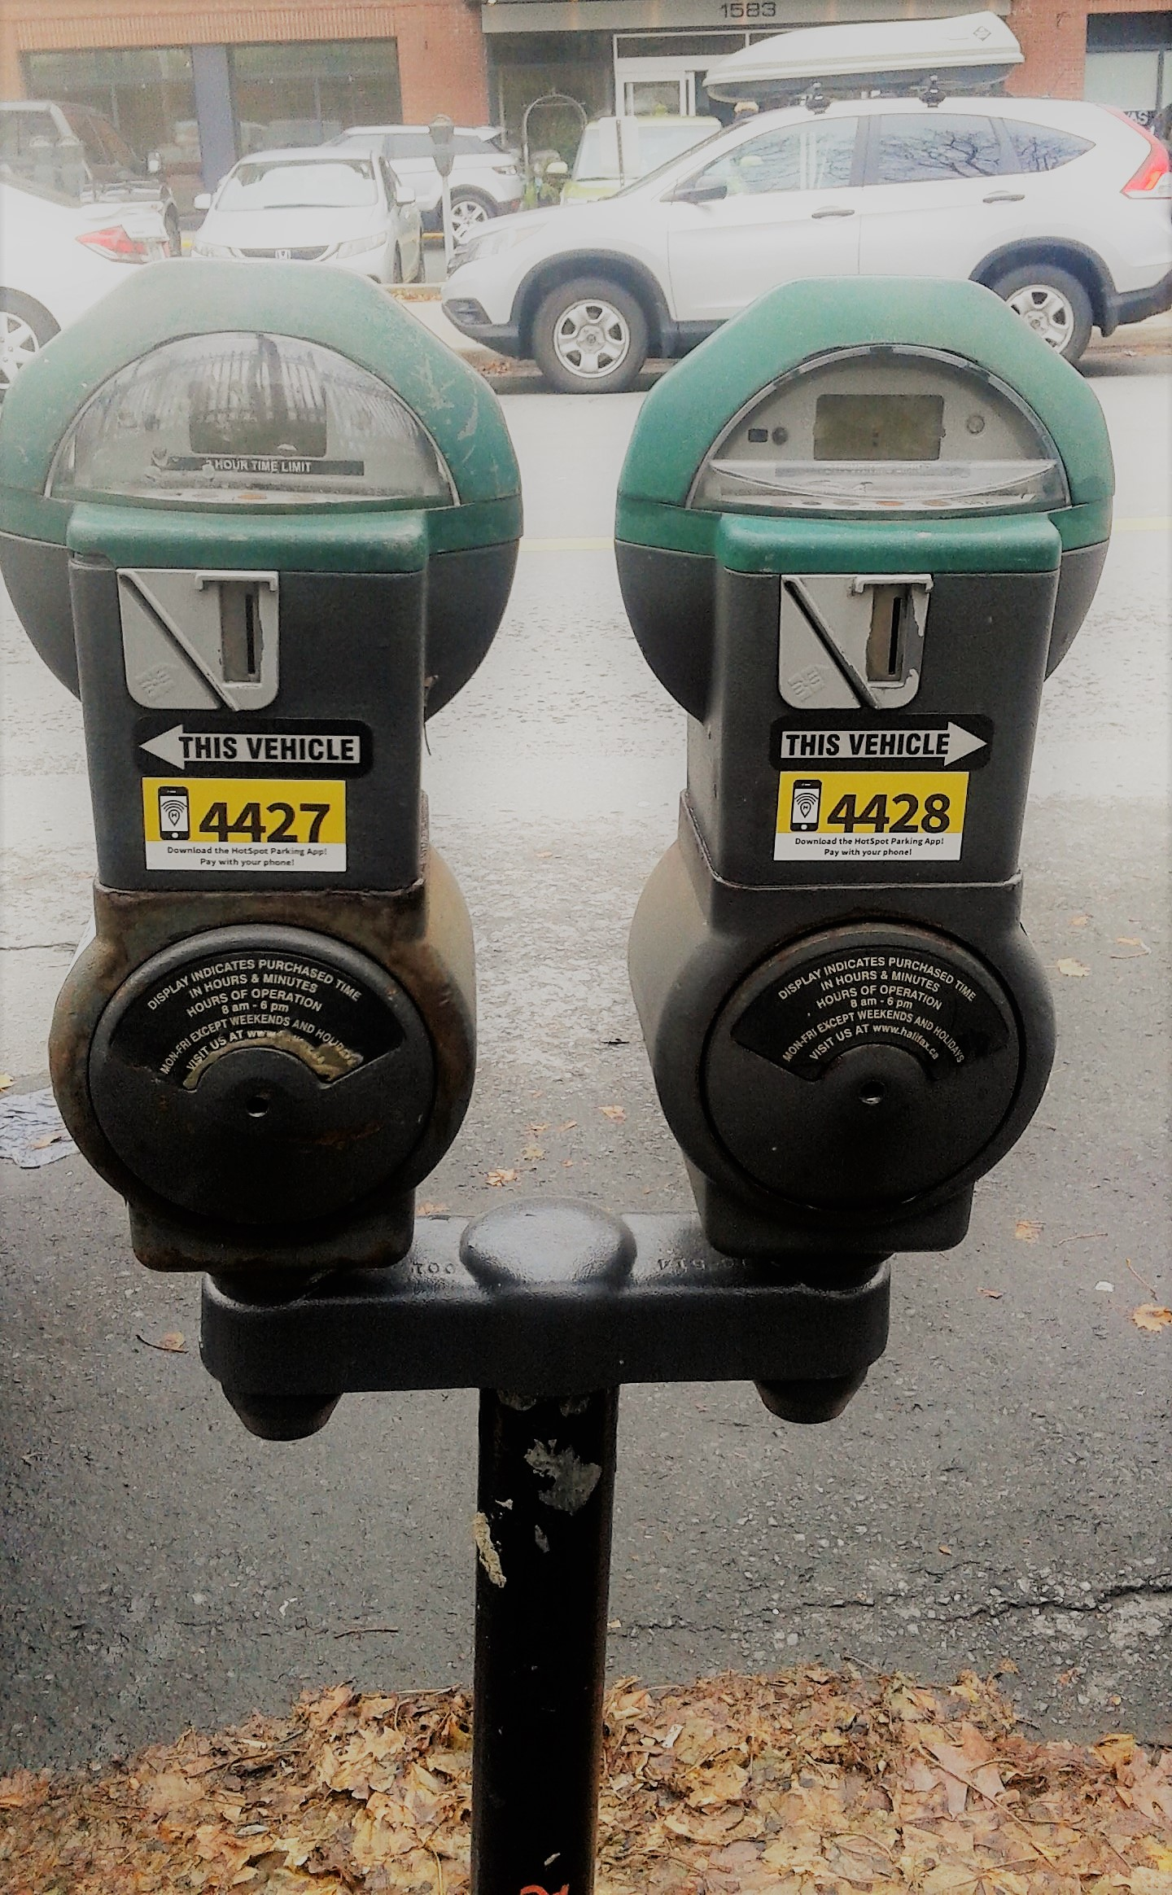
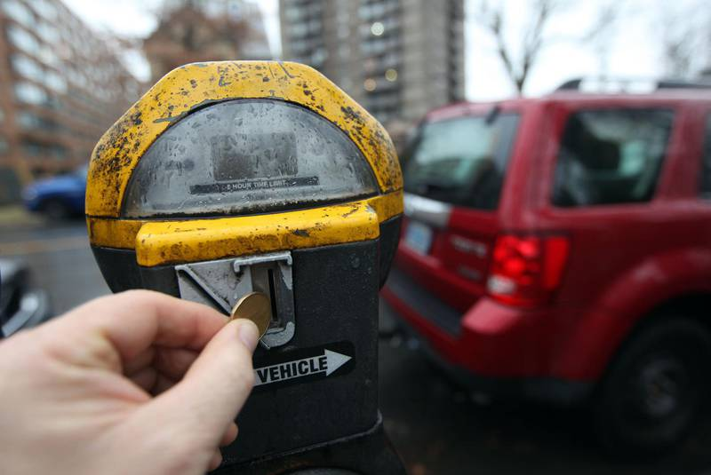
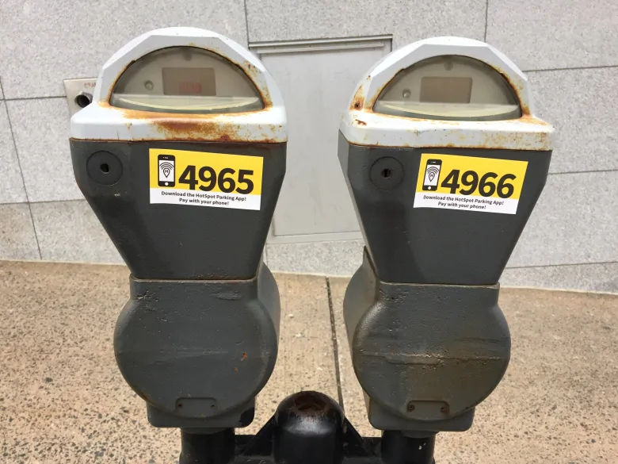
More than just the rules of the road

Slide 4
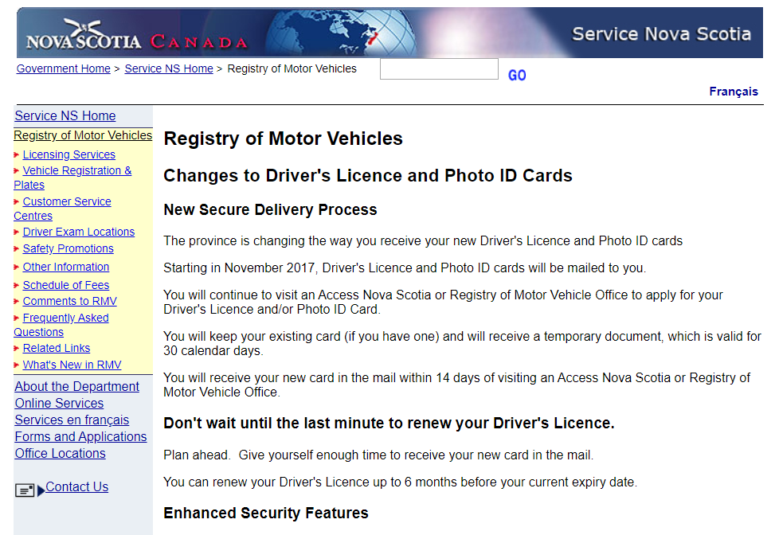
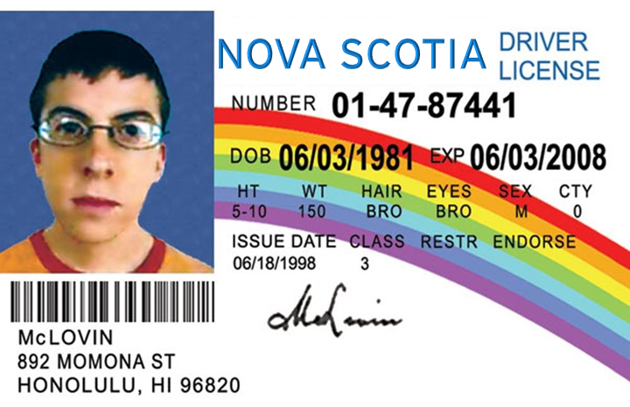
Navigate the system

Slide 5


Stay safe... Stay warm...

Slide 6
Study protocols
To better understand the challenges of our user groups and the potential features of most interest to each, our study will solicit feedback, ideas and gather the necessary user requirements to designing a needs-based and user-centric solution.
User groups
Group 1: Individuals with no Canadian driver’s license
Group 2: Individuals with a Canadian driver’s license but have limited to no driving experience
Group 3: Individuals with a Canadian learner’s permit
Group 4: Out of country individuals divided into two further sub-groups; A: individuals with limited to no driving experience and B: individuals with driving experience outside of Canada

Slide 7
Study protocols
To best reach the target audience within the time and resource constraints, an online survey is best suited to gather the necessary information.
Key features and design principles
Limiting the time to completion to < 10 minutes (1-2 minutes per question) to help achieve higher completion rates and gather impactful responses
Well-crafted and clear questions defined to gather the needed data across the user groups
Focus on closed-ended questions to concentrate on quantitative data for analysis purposes

Slide 8
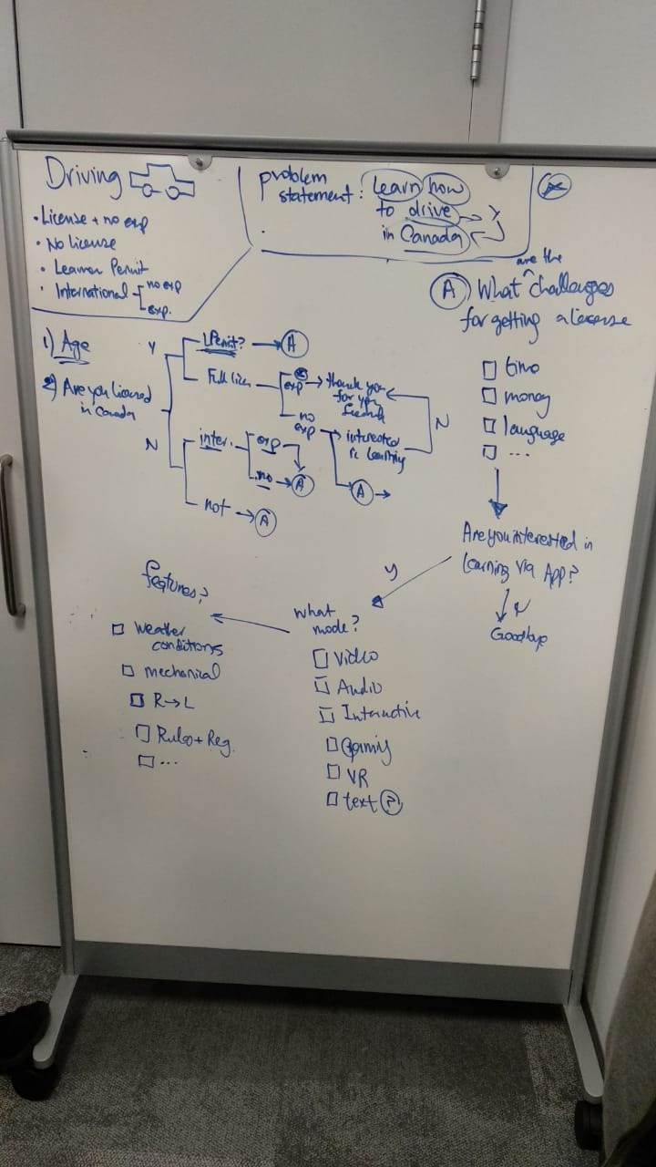
Survey questions
What is your age group? (Select only one)
[Series of questions] for user group classification
What are the challenges you think you will face for getting a license?
How much time do you want to spend a week learning to drive?
When you drive, the road conditions you encounter will be the most difficult to deal with.
Are you interested learning via an App?
What is your mode of preference for learning?
What features listed below, do you want to use in the learning app?

Slide 9
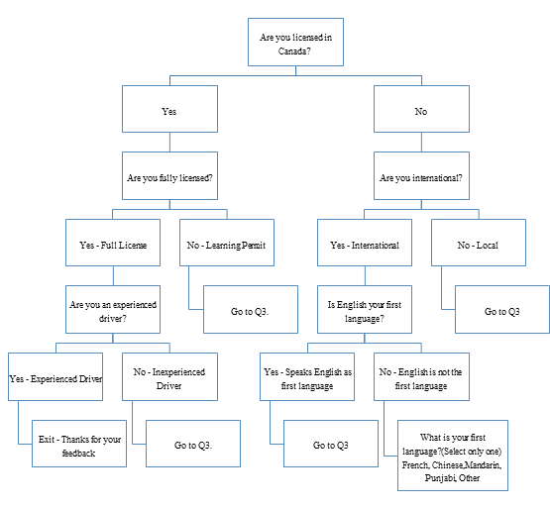
User group classification tree

Slide 10
Existing solutions
Before our team comes up with a new design, it is important to study the existing solutions and be familiar with their features. As discussed in the problem definition, we are trying to build a software platform where users can learn the initial steps required to start driving. Studying about the existing platforms will provide an idea as what features make the solution popular among the users. We can also learn from the weak features and work on the methods as how to overcome those in our new solution. Future is always built upon the experience we have derived from our history.

Slide 11
Summary of study
Learning Apps | Company | Ratings | Count of ratings | Size | No. of downloads | Compatibility
Learn Driving | Xtell Technologies | 3.8 | 577 | 4.2 M | 100000+ | Android
Driving theory test genius | Elegant elearning | 4.7 | 7800 | 268.6 M | 100000+ | ios
Learn to drive a manual car | Lovely AI | 4.0 | 746 | 5.3 M | 500000+ | Android
Traffic and Road Signs | Shoyo | 4.5 | 675 | 21 M | 100000+ | Android
Theory Test Pro | Well Informed Limited | 3.8 | 603 | 97 M | 100000+ | Android / ios
US DMV Driving Test | Monologix | 4.3 | 2839 | 12 M | 500000+ | Android
Simulation Apps
Parking Mania 2 | Mobirate | 4.1 | 32459 | 95 M | 1,000,000+ | Android
Dr Driving 2 | SUD | 4.3 | 535431 | 20 M | 50,000,000+ | Android
Driving School | Ovidiu Pop | 4.3 | 502408 | 27 M | 10,000,000+ | Android
Car Driving School Simulator | BoomBit Games | 4.4 | 181305 | Varies | 10,000,000+ | Android
35
25
15

Slide 12
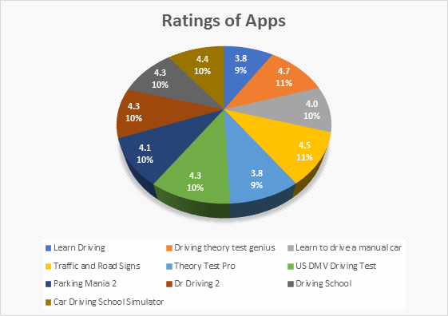
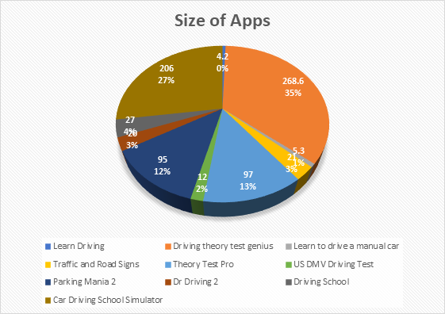
Rating
Size of apps

Slide 13
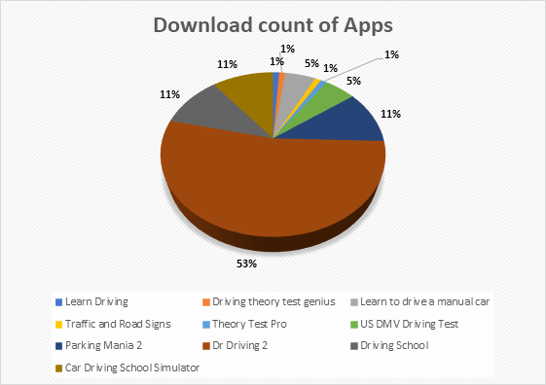
Downloads
Summary
Clearly, Simulation apps are the winners in terms of popularity in teaching driving skills with the most easily adaptable methods. But at the same time, these apps are expensive and definitely require highly compatible graphics devices for support. On the other hand, the educational oriented apps are simple yet efficiently help the users to pass the test. In short, our team would try to balance the best features of both the platforms and also add “out of box” thinking process to create a new design for teaching how to drive.

Slide 14
Questions?

Slide 15
Appendix A:
Driving Apps

Slide 16
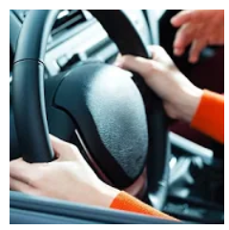
Existing solution #1:
Learn Driving
Key features
The objective of the app is to provide basic foundation for learning to drive without going to a driving school.
It provides step by step driving tutorials with the help of pictures.
Rating is 3.8/5.0
Available only for android
Size is 4.2 MB
Best critics say the app provides good information, useful for automatic driving, novice feel good, easy to use.
Worst critics find only pdf forms are provided containing the instructions, pages cannot be zoomed, downloading the app is slow, instructions include spelling mistakes.
The app is built by Xtell technologies. The company owns 65 apps and leads in multiple fields like – Education Tools, Food & Drink, Health & Fitness Personalization, Entertainment , Books & Reference, House & Home Finance, Lifestyle, Medical, Travel & Local Business, Shopping, Weather and many more.[2]

Slide 17

Existing solution #2:
Driving Theory Test Genius
Key features
Centred for United Kingdom (UK) users.
Prepares users for UK theory test for DVSA test where DVSA is Driver and Vehicle Standards Agency, an executive agency working for UK Department for Transport. Database for 725 questions. It provides mock tests based on the official 2019 Highway Code manual issued by DVSA. It also provides detailed explanation with difficulty levels from easy to exam mode.
Rating is 4.7/5.0
Available only for android and ios, offline facility.
Size is 268.6 M
Best critics say the app helps passing the theory test in first attempt.
Worst critics find repeated questions, low value for money, no audio feature, not for dyslexics.
Elegant e-learning has built the technology. Since 2008, the company has been educating learners in the USA, Canada, the UK, Australia, India and New Zealand. Their products are free, registration-free and ad-supported. On average, they have 200,000+ thousand daily users and they spend 11 minutes on site.

Slide 18
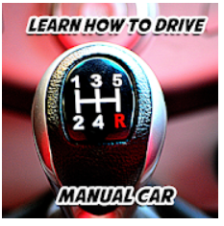
Existing solution #3:
Learn how to drive: Manual Car
Key features
Useful only for people who are willing to learn manual driving.
Available as offline.
Rating is 4.0/5.0
Available only for android
Size is 5.3 M
Best critics say completed learning in two weeks, easy to understand, informative, fun .
Worst critics find the app a waste.
Owner: Lovely AI

Slide 19

Existing solution #4:
Traffic and Road Signs
Key features
Provides instructions in 68 preferred languages.
Rating is 4.5/5.0
Available on android.
Size is 21 M
Best critics say the app is easy to use, covers all the road signs.
Worst critics found difficulty to switch the mode of instruction to English.
Shoyo has developed the add. The company has built 17 apps for education and games.

Slide 20

Existing solution #5:
Theory Test Pro
Key features
Again UK Based program
Bank of Multiple Choice questions containing all 960 practice questions.
A tutorial video and replay mode so that you can master the Hazard Perception test.
Rating is 4.0/5.0
Available for android and ios.
Size is 97 M
Best critics say driving instructors refer this app to learn.
Worst critics not value for money, freezing.
Owner: Well Informed Limited

Slide 21

Existing solution #6:
US DMV Driving test
Key features
It is ranked number 1 as Driving Test App in the US.
Only for US Drivers covered under Department of Motor Vehicles in USA.
Rating is 4.3/5.0
Available on android.
Size is 12 M
Best critics say the app is easy to learn state specific signs, adapt the rules on wheels.
Worst critics say failed the test after using the app, has a lot of wrong answers, misleading.
Monologix, Inc. has come up with designing and building the app.

Slide 22
Appendix B:
Simulation Apps and Games

Slide 23

Simulation Apps and Games #1:
Parking Mania 2
Key features
3D graphics
Road Challenges, reverse parking, simple practice with accelerator pedal, brake pedal and steering wheel.
Rating is 4.015.0
Available only for android.
Size is 95 M
Price is $1.39 - $69.99 per item
Best critics say best graphics, fun, good physics.
Worst critics black screen, awful racing, too much advertising.
Owner: Mobirate

Slide 24
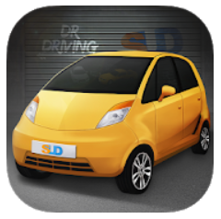
Simulation Apps and Games #2:
Dr Driving 2
Key features
Stunning Graphics
Challenging multi-stage levels
Realtime online multiplayer
Rating is 4.3/5.0
Available for android.
Size is 20 M
Price is $2.29 - $129.99 per item
Best critics say smooth controllers, addictive, fun, most instructional yet creative.
Worst critics says time wait is more to open new level, too many ads, car update is not good, more crashing of cars.
Owner: SUD Inc.

Slide 25

Simulation Apps and Games #3:
Driving School
Key features
Teaches driving many different cars
Covers different environments like cities, country roads, highways, deserts, mountains, etc.
Playing with friends.
Free multiplayer modes.
Rating is 4.3/5.0
Available for android.
Size is 27 M
Price is $1.19 - $17.99 per item
Best critics say good graphics, teaches teens, offline facility available.
Worst critics say not easy to find controls, buttons not working, bug about not completing a level.
Owner: Ovidiu Pop

Slide 26

Simulation Apps and Games #4:
Car Driving School Simulator
Key features
Covers California, New York and Canada
Focuses on traffic rules
26 unique cars
Online multiplayer free roaming mode
Rating is 4.4/5.0
Available for android.
Size varies with device
Price is $2.49 - $30.99 per item
Best critics say addictive, optimization, realistic.
Worst critics says no proper instructions, unpredictable controls, too many ads.
BoomBit Games

